Slide 1
Music Genre Classification
using CNNs

Slide 2
CONTENTS
Description
About Dataset
Objectives
Algorithm used
Results
Knowledge gained from this project
References

Slide 3
Description
-Classification of Music Genre by implementing CNN
- Explored and compared various features extraction and how they affect the accuracy of the CNN.

Slide 4
About Dataset
I have used GTZAN Dataset
Number of Genres - 10
Number of samples - 66000
Download link https://www.kaggle.com/carlthome/gtzan-genre-collection

Slide 5
Objectives
Genre Classification using CNN
Explore and Compare Feature selection techniques(melspectrogram, MFCC, Chroma)

Slide 6
Algorithm
For each feature extraction technique(Melspectrogram, MFCC, Chroma):
Shuffle the input and split into train and test (70%/30%).
Read the audios as their respective feature extraction(e.g in case of MFCC read the audios as MFCC), splitting them into 1.5s windows with 50% overlapping resulting in a dataset with shape (samples x time x frequency x channels)
Train the CNN and test on test set using a Majority Voting approach

Slide 7
Results
Feature Extraction technique | Accuracy | val_loss | Majority voting
Melspectrogram | 70.1% | 0.985 | 78.3%
MFCC | 70.3% | 0.983 | 80.7%
Chroma | 10% | 0.2303

Slide 8
Melspectrogram
01

Slide 9
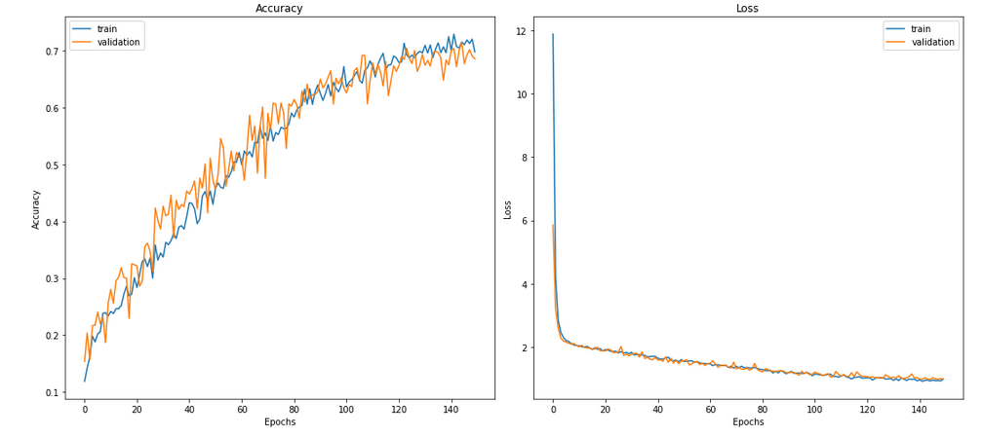

Slide 10
MFCC
02

Slide 11
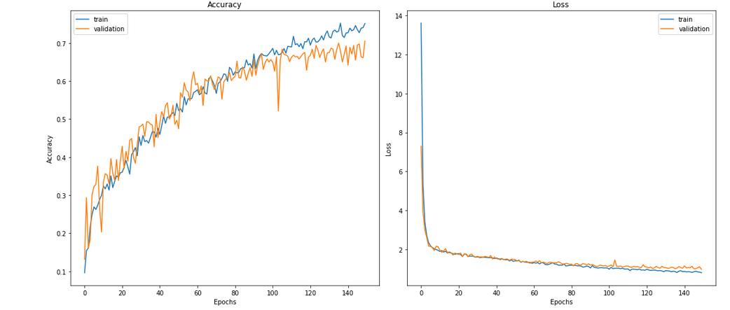

Slide 12
Chroma(STFT)
03

Slide 13
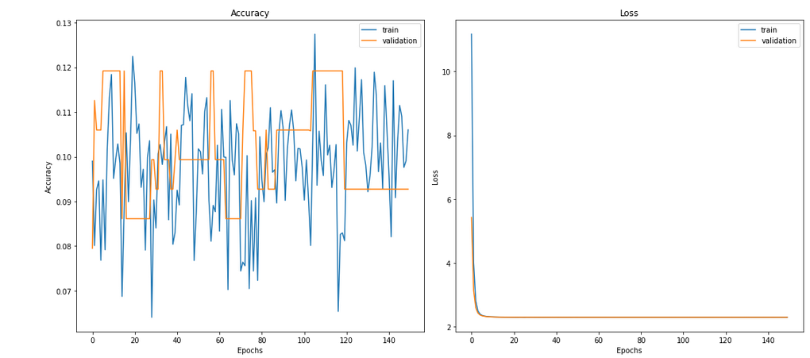

Slide 14
Knowledge Gained from this project
Sampling audios
Different Feature selection criteria for audio Data
Classification of audio Data using CNN
Using Github

Slide 15
References
[1]https://github.com/madhuradole/Music-Genre-Classification-Machine-Learning-/tree/master/MusicGenre
[2]https://github.com/Hguimaraes/gtzan.keras/blob/master/nbs/1.1-custom_cnn_2d.ipynb
[3]https://towardsdatascience.com/getting-to-know-the-mel-spectrogram-31bca3e2d9d0

